Slide 1

Module 14: CMOS cell layout 2
OHIO UNIVERSITY – SCHOOL OF EECS – EE5143 – DIGITAL DESIGN WITH VHDL AND VSLI

Slide 2
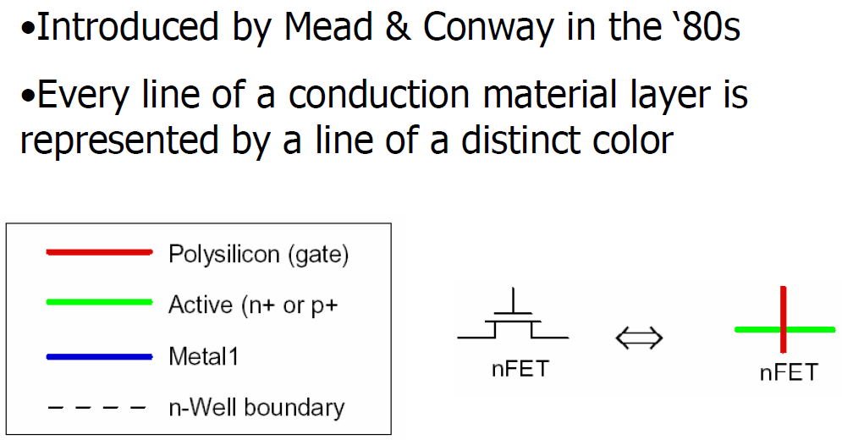
Stick diagram
Stick diagram representation of CMOS layout

Slide 3
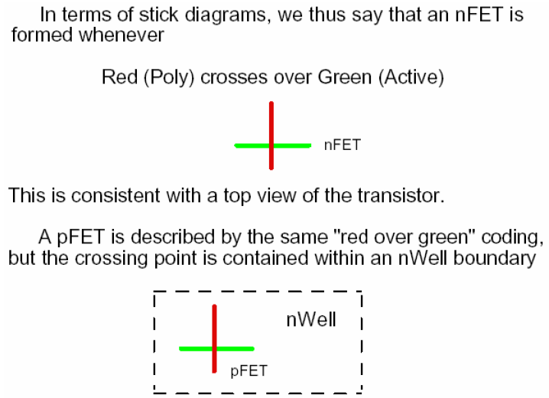
CMOS layout
Stick diagram representation of CMOS layout

Slide 4
CMOS layout
Stick diagram representation of CMOS layout

Slide 5
CMOS layout
Stick diagram representation of CMOS layout

Slide 6
CMOS layout
Stick diagram representation of CMOS layout

Slide 7
CMOS layout
Stick diagram representation of CMOS layout

Slide 8
CMOS layout
Stick diagrams for CMOs inverters

Slide 9
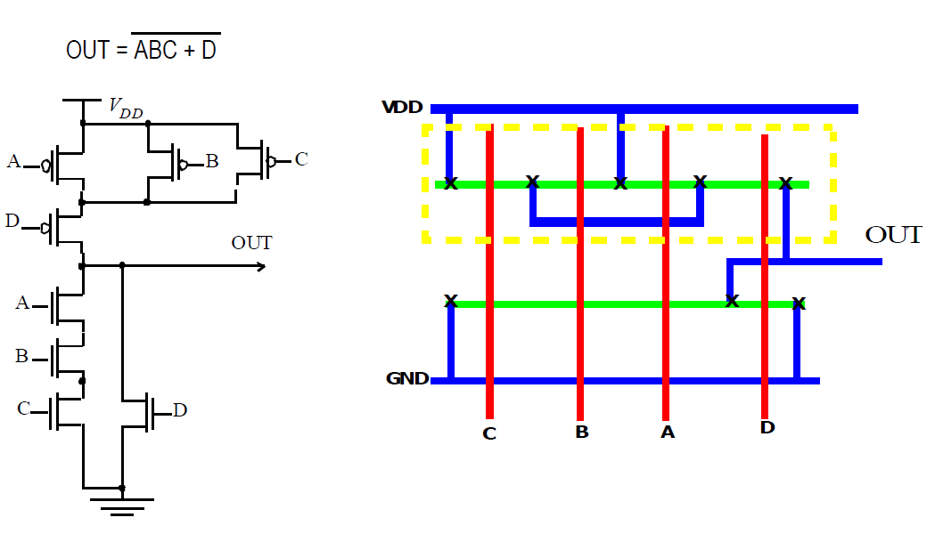
CMOS layout
Stick diagram for a combinational logic circuit

Slide 10
CMOS layout
CMOS Cell partitioning and floor planning
Because of the complexity of today’s integrated circuits with millions and billions of transistors on a single chip highly methodical and hierarchical design approaches are needed. Circuit design and layout is thus a highly organized process.
The usual practice is to design large complex circuits as an assembly of smaller more manageable circuits with well-defined interfaces. These smaller circuit blocks are themselves made up of circuit cells. Each cell can be as simple as a single logic gate or a small combinational circuit. Each block is carefully partitioned into cells so that it can be laid out in a logical arrangement.
On an even higher level the chip itself is divided into major functional areas in a process called floor planning. For example, in the case of a processor the major functional areas can be cache memory, control unit, arithmetic logic unit (ALU) etc. All of these functional blocks are contained within an outer ring of I/O pads.

Slide 11
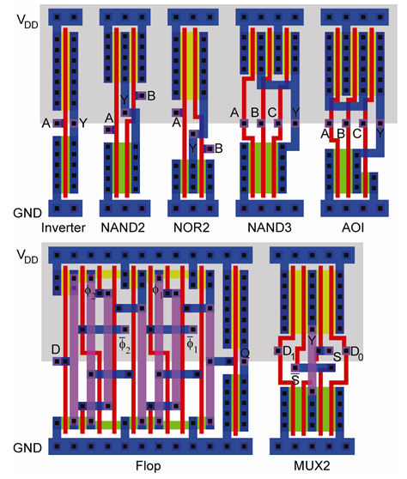
CMOS layout
CMOS Cell partitioning and floor planning
Some examples of CMOS cell layouts can be seen here.
The top row shows various logic gates:
Inverter, 2-input NAND gate, 2-input NOR gate, 3-input NAND gate and an AND-OR-Invert circuit.
The bottom row shows a D flip-flop and a 2-input multiplexer.

Slide 12
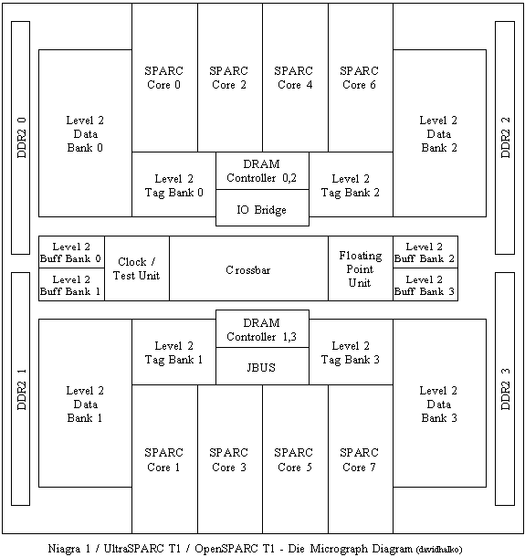
CMOS layout
CMOS Cell partitioning and floorplanning
The floorplan from an UltraSPARC T1 microprocessor is shown here. The I/O pad ring is not seen.
The space between the circuit blocks is used for signal routing and is thus referred to as routing channels.

